Slide 1

Mastering LangChain: Enhancing LLM Applications with Advanced Workflows
Integrating open-source toolkit to build advanced workflows
Notes:
In this presentation, we will explore LangChain, an open-source toolkit designed to enhance LLM applications. We will learn about LangChain's features, use cases, and integrations, and walk through examples of how to use LangChain to build advanced workflows.

Slide 2
Presentation Outline
Introduction to LangChain
Setting Up Environment
Basic Components of LangChain
Advanced Use Cases
Connecting to APIs and External Tools
LangChain in Production
Notes:
We will start with an introduction to LangChain, learning about its features and key use cases, and how it integrates with various LLMs. Then, we will dive into the setup process, teaching participants how to install and set up LangChain locally. Next, we will explore the core components of LangChain, building a simple chain that combines an LLM with a search engine. After that, we will explore advanced use cases and integrations, building a RAG system to retrieve information from documents and answer questions using an LLM. Finally, we will demonstrate how LangChain can integrate with external systems and explore deployment strategies and best practices.

Slide 3
Introduction to LangChain
Notes:
LangChain is an open-source toolkit designed to enhance LLM applications. Its features include document retrieval, prompt engineering, and multi-agent workflows. LangChain can integrate with various LLMs, including OpenAI’s GPT and Hugging Face models. In this section, we will learn about LangChain's key use cases and explore a simple example demonstrating LangChain in action.

Slide 4
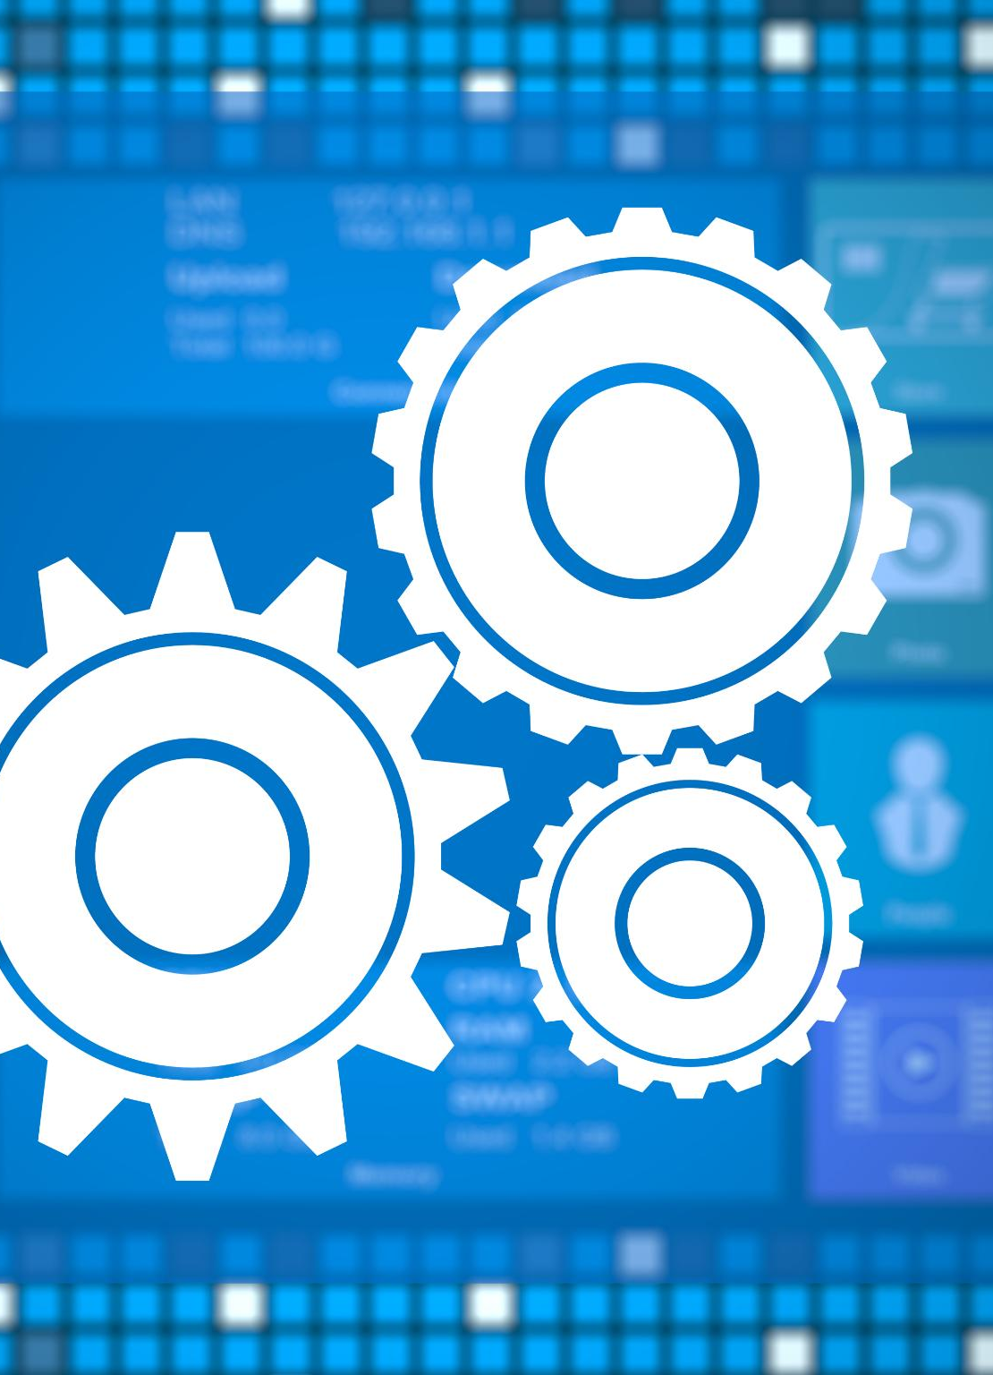
Overview of LangChain's Features
Document Retrieval
LangChain's document retrieval feature allows users to search and retrieve relevant documents quickly and efficiently, making LLM applications more effective and efficient.
Prompt Engineering
LangChain's prompt engineering feature enables users to create custom prompts for LLM applications, increasing the accuracy and efficiency of the system.
Multi-Agent Workflows
LangChain's multi-agent workflows feature allows for collaboration between multiple agents, making LLM applications more efficient and effective.
Notes:
LangChain's features include document retrieval, prompt engineering, and multi-agent workflows. These features are designed to enhance LLM applications and make them more effective and efficient.

Slide 5

Key Use Cases: Document Retrieval, Prompt Engineering, and Multi-Agent Workflows
Document Retrieval
Document retrieval is a key use case for LangChain's LLM applications, allowing users to efficiently search and access relevant information from large repositories of data.
Prompt Engineering
Prompt engineering is another key use case for LangChain's LLM applications, enabling users to generate effective prompts for language models that can improve their accuracy and effectiveness.
Multi-Agent Workflows
Multi-agent workflows are a key use case for LangChain's LLM applications, allowing multiple agents to collaborate and make complex decisions based on multiple factors.
Notes:
LangChain's key use cases include document retrieval, prompt engineering, and multi-agent workflows. These use cases enable LLM applications to retrieve relevant information, generate effective prompts, and make complex decisions based on multiple factors.

Slide 6

Integration with Various LLMs Like OpenAI’s GPT, and Hugging Face Models
LangChain's integration with various LLMs, including OpenAI’s GPT and Hugging Face models, enables LangChain to enhance the capabilities of these models and make them more effective in a wide range of applications.
Notes:
LangChain can integrate with various LLMs, including OpenAI’s GPT and Hugging Face models. This integration enables LangChain to enhance the capabilities of these models and make them more effective in a wide range of applications.

Slide 7
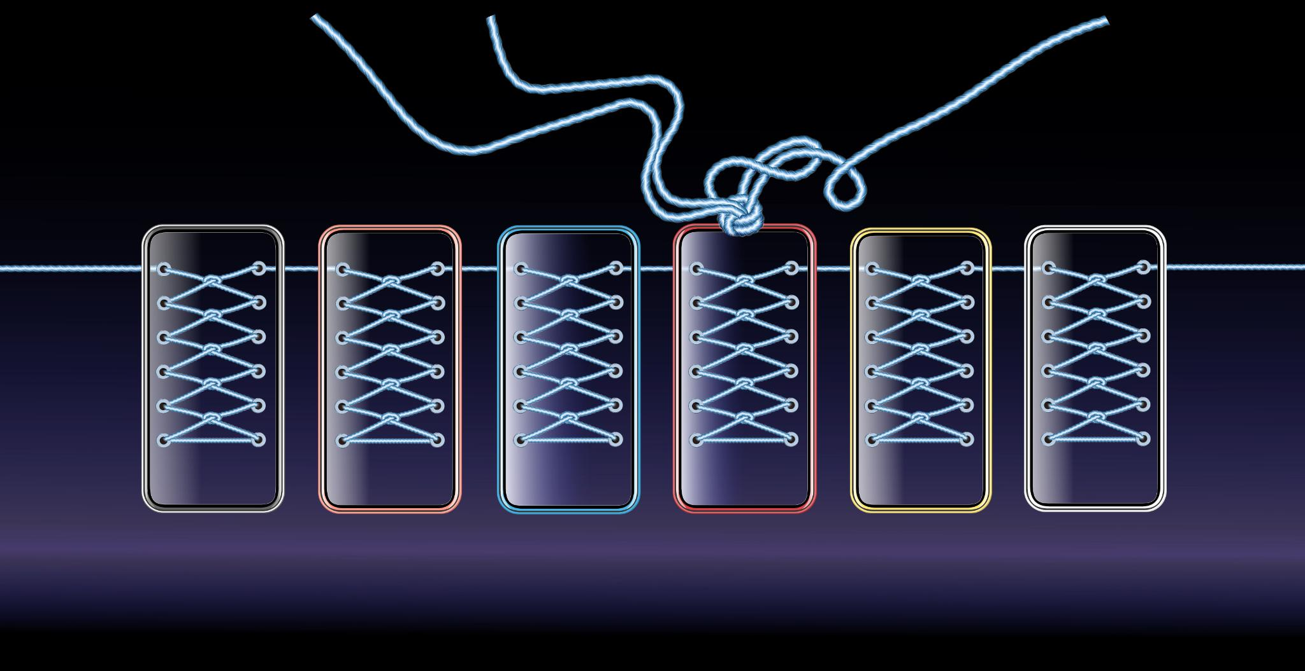
Activity: Simple Example Demonstrating LangChain in Action
Participants will walk through a simple example demonstrating LangChain in action. This activity will provide hands-on experience with LangChain's features and capabilities.
Notes:
Participants will walk through a simple example demonstrating LangChain in action. This activity will provide hands-on experience with LangChain's features and capabilities.

Slide 8
Setting Up Environment
Notes:
Before using LangChain, participants must set up their environment. This section will guide participants through the setup process, including Python environment setup, installing supporting libraries, and setting up LangChain locally.

Slide 9

Python Environment Setup
Participants will learn how to set up a Python environment to use LangChain. This will include installing Python and any necessary dependencies.
Notes:
Participants will learn how to set up a Python environment to use LangChain. This will include installing Python and any necessary dependencies.

Slide 10

Use of Conda and Venv
Conda and Venv are popular tools for managing Python environments. They allow developers to easily create, manage, and switch between different Python environments for different projects.
Notes:
Participants will learn about using Conda and Venv to manage their Python environment.

Slide 11
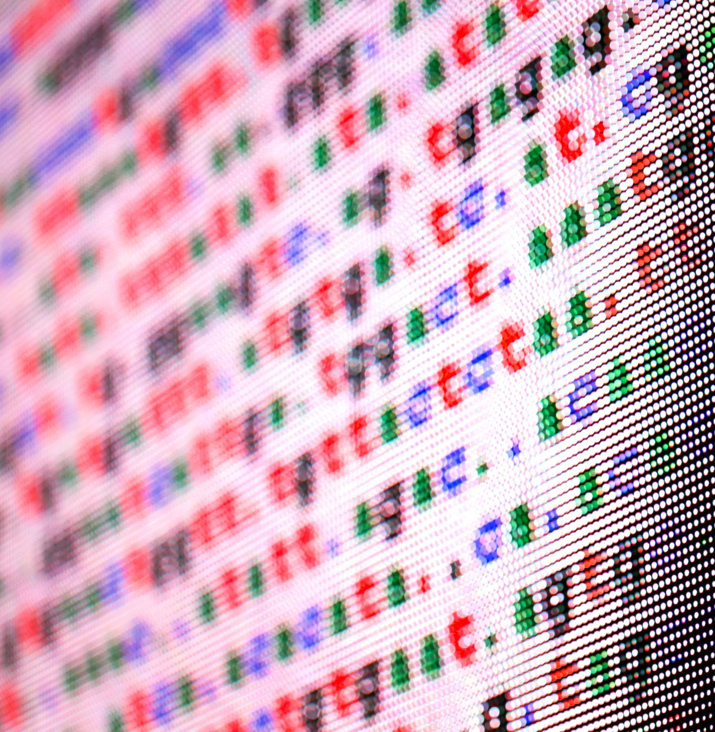
Installing Supporting Libraries
Supporting Libraries
LangChain requires a number of supporting libraries in order to function properly. Participants will learn about these libraries and how to install them.
Installation Process
Participants will learn about the installation process for the supporting libraries required to use LangChain. They will be provided with step-by-step instructions and practical examples.
Notes:
Participants will learn about the supporting libraries required to use LangChain and how to install them.

Slide 12
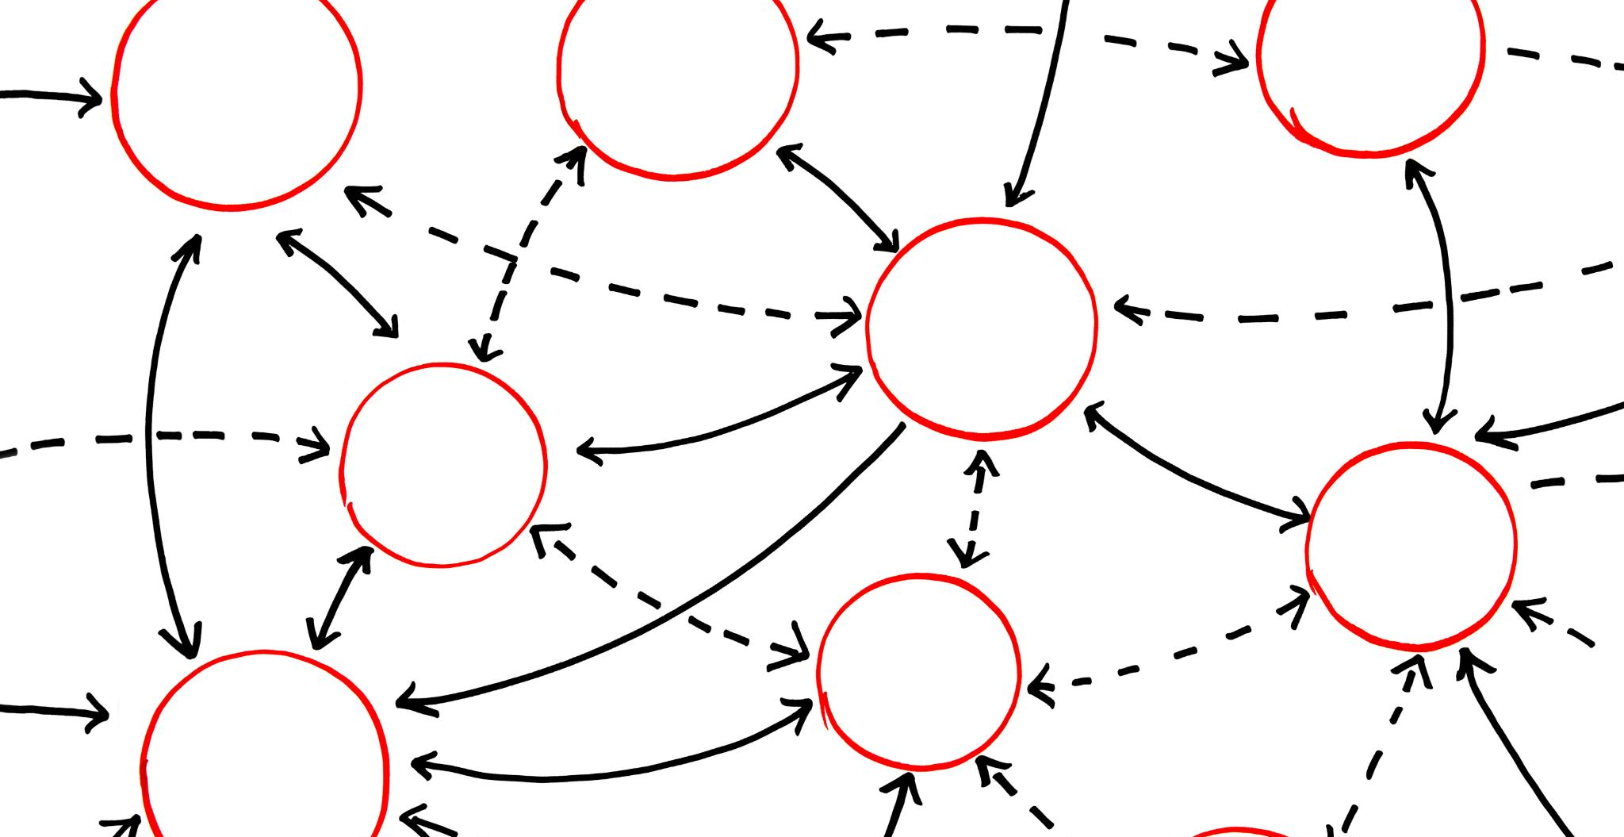
Activity: Participants Install and Set up LangChain Locally
Participants will follow a step-by-step guide to install and set up LangChain locally, gaining hands-on experience with the setup process.
Notes:
Participants will follow a step-by-step guide to install and set up LangChain locally. This activity will provide hands-on experience with the setup process.

Slide 13
Basic Components of LangChain
Notes:
LangChain is composed of several core components, including chains, agents, memory, and retrievers. In this section, we will explore these components in detail and build a simple chain that combines an LLM with a search engine.

Slide 14

Chains: Sequential Operations (LLMChain, SimpleChain)
Chains
Chains are a sequence of operations that can be composed to create more complex workflows. They are used in LangChain to configure custom workflows that meet specific business requirements.
LLMChains
LLMChains are a type of chain in LangChain that allow you to configure complex workflows by defining multiple stages and actions in each stage. LLMChains are useful for automating complex business processes.
SimpleChains
SimpleChains are a type of chain in LangChain that allow you to configure simple workflows by defining a sequence of actions. SimpleChains are useful for automating repetitive tasks.
Notes:
Chains are a sequence of operations that can be composed to create more complex workflows. LangChain includes several types of chains, including LLMChains and SimpleChains.

Slide 15

Agents: Dynamic Decision-Making with Tools (Web Scraping)
Agents
Agents are dynamic decision-making components that can interact with web pages, databases and other tools. They can perform a range of tasks, such as extracting data, automating tasks, and making decisions.
Web Scraping Agents
Web-scraping agents are a type of agent that can extract data from websites and web pages. They can be used for a variety of purposes, such as monitoring prices, collecting data, or automating tasks.
Notes:
Agents are dynamic decision-making components that can interact with web pages and other tools. LangChain includes several types of agents, including web-scraping agents.

Slide 16
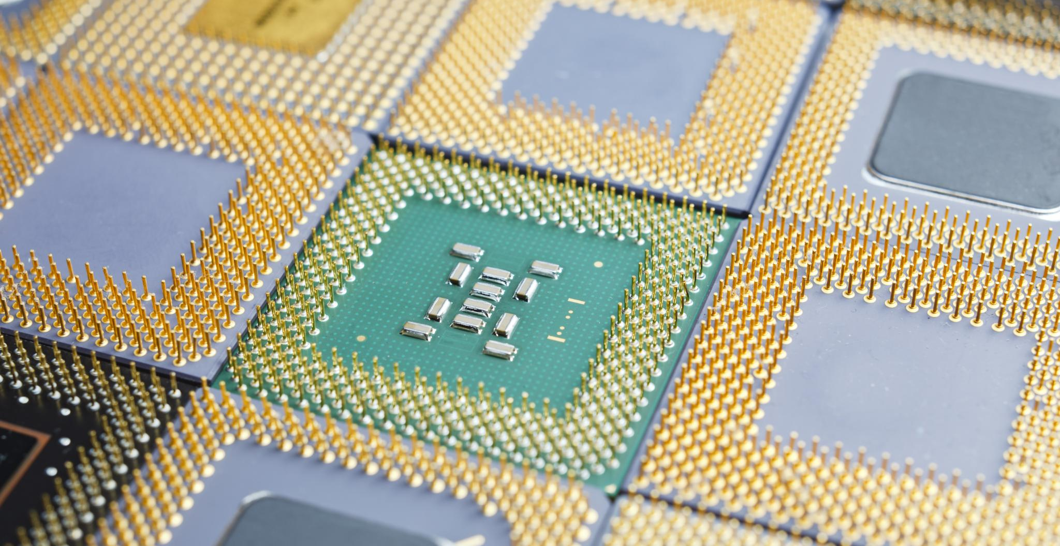
Memory: Retaining Context over Multiple Interactions
Memory is a core component of LangChain that allows it to retain context over multiple interactions, enabling it to better understand complex workflows and multi-agent systems.
Notes:
Memory is a component of LangChain that enables it to retain context over multiple interactions. This is useful for complex workflows and multi-agent systems.

Slide 17

Retrievers: Retrieving Relevant Information Using Tools Like FAISS
Retrievers are a key component of LangChain, enabling the system to search large datasets efficiently and retrieve relevant information using tools like FAISS.
Notes:
Retrievers are components that enable LangChain to retrieve relevant information from large datasets. LangChain includes retrievers that use tools like FAISS to efficiently search large datasets.

Slide 18

Activity: Build a Simple Chain Combining an LLM with a Search Engine
Step-by-Step Guide
Participants will have access to a detailed step-by-step guide that will take them through the process of building a simple chain that combines an LLM with a search engine. The guide will provide hands-on experience with LangChain's core components.
LangChain's Core Components
The activity will provide hands-on experience with LangChain's core components, allowing participants to gain a better understanding of how they work and how they can be used to build complex language models.
Notes:
Participants will follow a step-by-step guide to build a simple chain that combines an LLM with a search engine. This activity will provide hands-on experience with LangChain's core components.

Slide 19
Advanced Use Cases
Notes:
LangChain can be used for a wide range of advanced use cases, including RAG for document Q&A, building multi-step workflows, and integrating custom tools with LangChain agents. In this section, we will explore several advanced use cases.

Slide 20

RAG for Document Q&A
What is RAG?
RAG is a powerful tool for document Q&A that combines a retriever, an LLM, and a generator. It enables users to build powerful document Q&A systems that can retrieve information from a large corpus of documents and generate human-like answers to complex questions.
Retriever
The retriever component of RAG is responsible for retrieving relevant information from a large corpus of documents, based on the keywords and phrases in the user's query.
LLM
The LLM component of RAG is responsible for understanding the meaning of the user's query and generating candidate answers based on the relevant content in the corpus.
Generator
The generator component of RAG is responsible for selecting the best answer from the candidate answers generated by the LLM and generating a human-like response to the user's query.
Notes:
RAG is a powerful tool for document Q&A that combines a retriever, an LLM, and a generator. LangChain includes support for RAG, enabling users to build powerful document Q&A systems.

Slide 21

Building Multi-Step Workflows Combining Various Tools and APIs
Multi-Step Workflows
LangChain can be used to build multi-step workflows that can handle complex tasks and automate workflows, saving time and effort.
Combining Various Tools and APIs
LangChain allows users to combine various tools and APIs to build powerful and flexible workflows that can handle a wide range of tasks.
Task Automation
LangChain enables task automation, which can help users save time and effort, increase productivity and reduce errors in workflows.
Notes:
LangChain can be used to build complex multi-step workflows that combine various tools and APIs. This enables users to create powerful and flexible workflows that can handle a wide range of tasks.

Slide 22
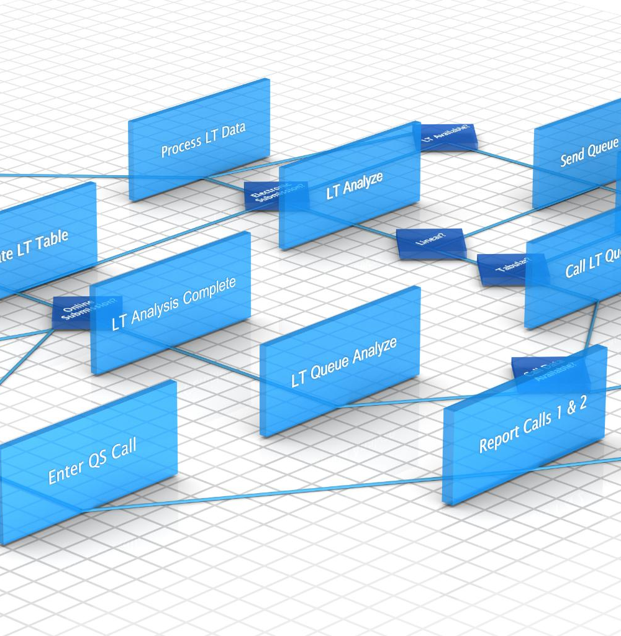
Integrating Custom Tools with LangChain Agents
Custom Tools and APIs
LangChain agents can be extended with custom tools and APIs to build customized solutions tailored to the specific needs of users.
Enhanced Integration
Integrating custom tools with LangChain agents enhances the integration of workflows, making it easier to manage tasks and achieve goals.
Notes:
LangChain agents can be extended to include custom tools and APIs. This enables users to integrate their own tools and workflows with LangChain and build customized solutions that meet their specific needs.

Slide 23
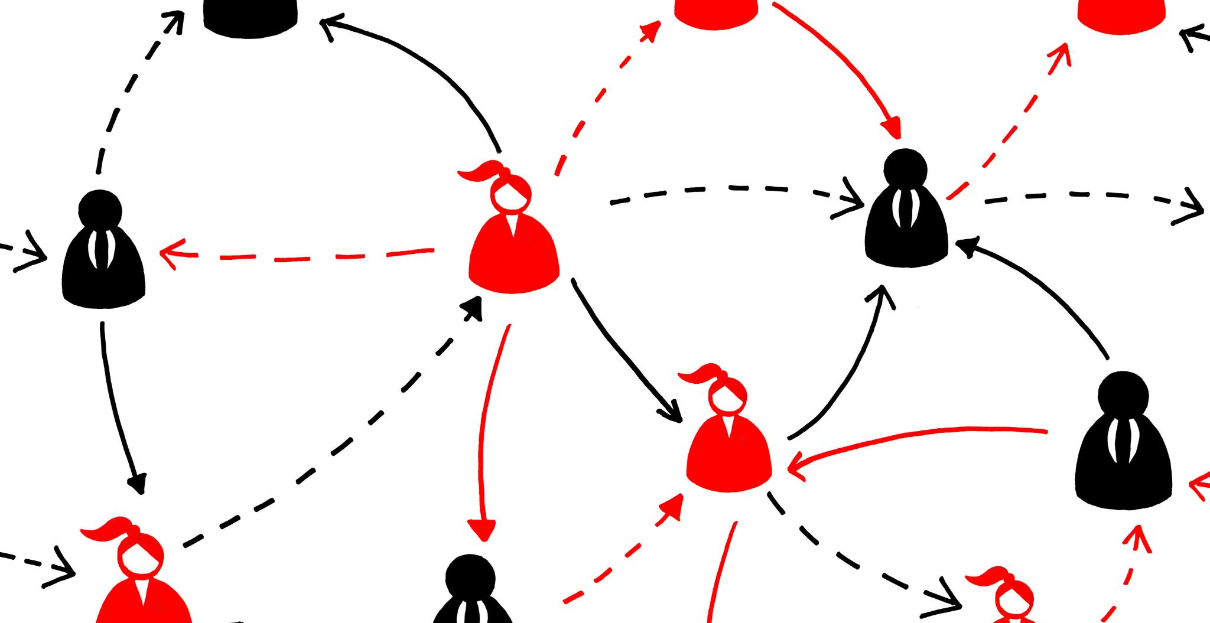
Managing Multi-Agent Systems
LangChain has built-in support for managing multi-agent systems to enable users to build complex systems that can handle multiple tasks and workflows with ease.
Notes:
LangChain includes support for managing multi-agent systems, enabling users to build complex systems that can handle multiple tasks and workflows.

Slide 24

Activity: Build a RAG System to Retrieve Information From Documents and Answer Questions Using an LLM
Building a RAG System
During this activity, participants will gain hands-on experience with building a RAG system using LangChain. They will follow a step-by-step guide to build the system and retrieve information from documents to answer questions.
Using LangChain
LangChain is a powerful tool that enables users to build advanced natural language processing workflows. Participants in this activity will learn how to use LangChain to build a RAG system.
Hands-on Experience
This activity will provide participants with hands-on experience with building a RAG system using LangChain. They will learn how to retrieve information from documents and answer questions using the system.
Notes:
Participants will follow a step-by-step guide to build a RAG system using LangChain. This activity will provide hands-on experience with advanced LangChain workflows.

Slide 25
Connecting to APIs and External Tools
Notes:
LangChain can be used to connect to external APIs and tools, enabling users to build more powerful and flexible workflows. In this section, we will explore how to connect LangChain with external systems.

Slide 26
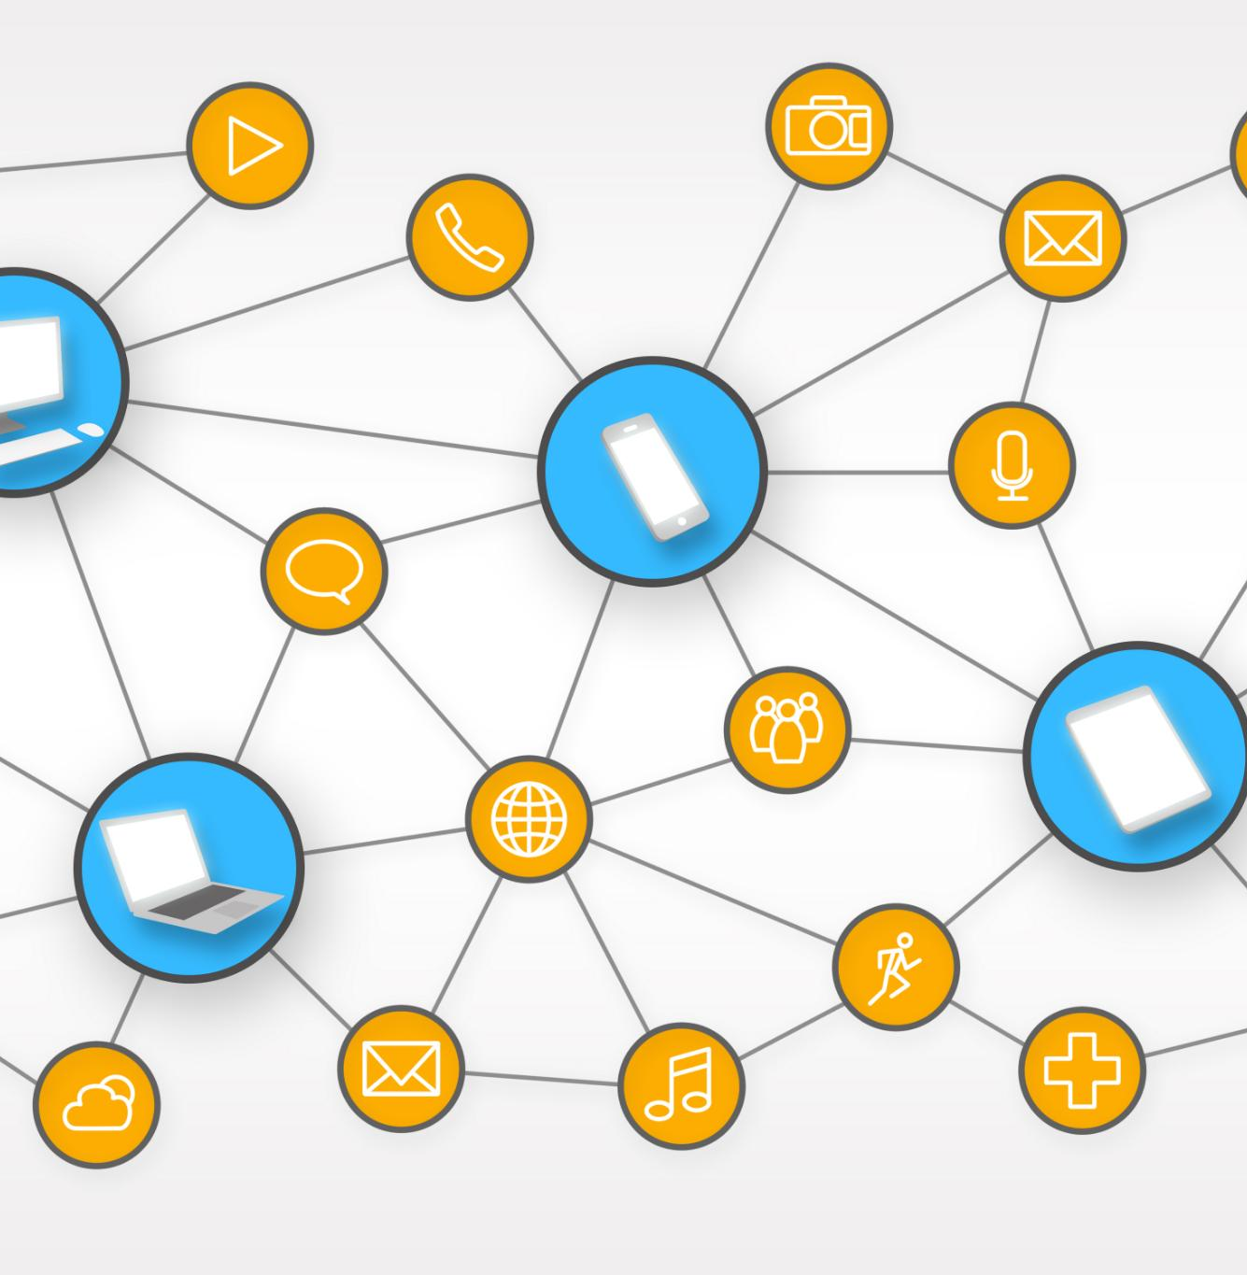
API Integration Using LangChain's Tools
API Integration Tools
LangChain's API integration tools allow users to connect LangChain with external systems, enabling seamless data transfer and integration.
Wide Range of External Systems
LangChain's integration tools support a wide range of external systems, including CRMs, ERPs, marketing automation tools, and more.
Notes:
LangChain includes tools for integrating with APIs and other external systems. These tools enable users to connect LangChain with a wide range of external systems.

Slide 27

Example of Connecting to APIs (Weather, Search Engines)
Connecting to Weather APIs
Participants will learn how to connect LangChain with weather APIs, retrieve weather data, and use this data in their applications.
Connecting to Search Engines
Participants will learn how to connect LangChain with search engines, retrieve search results, and use this data in their applications.
Notes:
Participants will learn how to connect LangChain with external systems, including weather APIs and search engines. This will provide hands-on experience with connecting LangChain with external systems.

Slide 28

Using LangChain with Web Scraping or Other Dynamic Content Sources
LangChain can be used effectively with web scraping and other dynamic content sources to build powerful workflows. These workflows can interact with web pages and other dynamic content sources, enabling automated data extraction and processing.
Notes:
LangChain can be used with web scraping and other dynamic content sources. This enables users to build powerful workflows that interact with web pages and other dynamic content sources.

Slide 29

Activity: Implement an Agent that Fetches Data From an External API, Processes It, and Returns a Result
Connecting to an External API
The first step to implementing an agent that fetches data from an external API is to connect to the API and retrieve the data. Participants will learn how to establish a connection and authenticate their access to the API.
Processing External Data
Once the data is retrieved from the external API, it needs to be processed to extract the relevant information. Participants will learn how to parse and manipulate the data to obtain the desired output.
Returning a Result
After the data has been processed, it needs to be returned in a usable format. Participants will learn how to format and present the data to make it accessible for other systems or users.
Notes:
Participants will follow a step-by-step guide to implement an agent that fetches data from an external API, processes it, and returns a result. This activity will provide hands-on experience with connecting LangChain with external systems.

Slide 30
LangChain in Production
Notes:
In this final section, we will explore deployment strategies, scaling, and best practices for using LangChain in production environments.

Slide 31
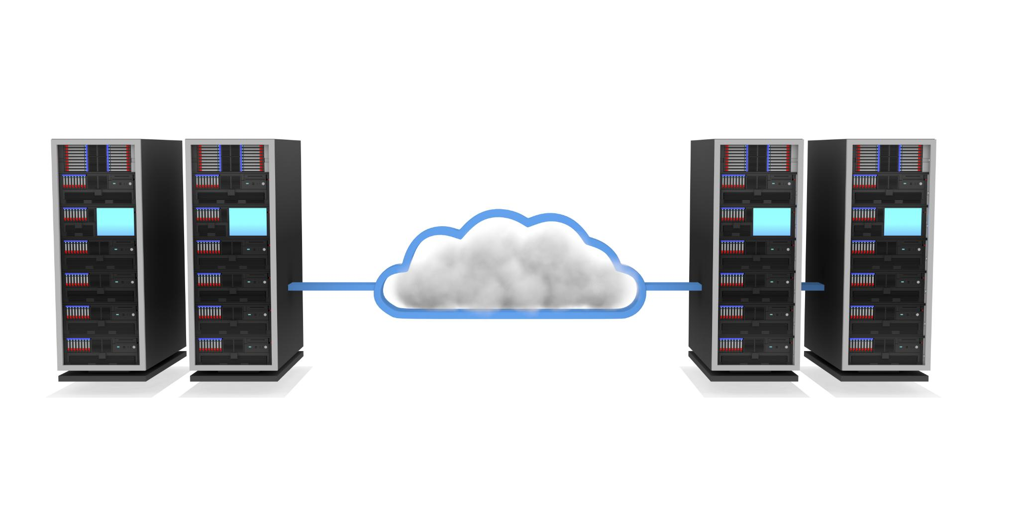
Deployment Strategies: Using Cloud Platforms (AWS, Azure, GCP)
Deploying LangChain on cloud platforms like AWS, Azure, and GCP enables users to scale their workflows and deploy LangChain in production environments.
Notes:
LangChain can be deployed on various cloud platforms, including AWS, Azure, and GCP. This enables users to scale their workflows and deploy LangChain in production environments.

Slide 32

Scaling: Using LangChain in Distributed Systems (with Kubernetes, Docker)
LangChain for Distributed Systems
LangChain can be used in distributed systems to enable horizontal scaling of workflows, improving efficiency and reducing costs.
Kubernetes and Docker for LangChain Deployment
Kubernetes and Docker can be used to deploy LangChain in distributed systems, providing a scalable and reliable platform for running LangChain workflows.
Notes:
LangChain can be used in distributed systems, enabling users to scale their workflows horizontally. Kubernetes and Docker can be used to deploy LangChain in distributed systems.

Slide 33
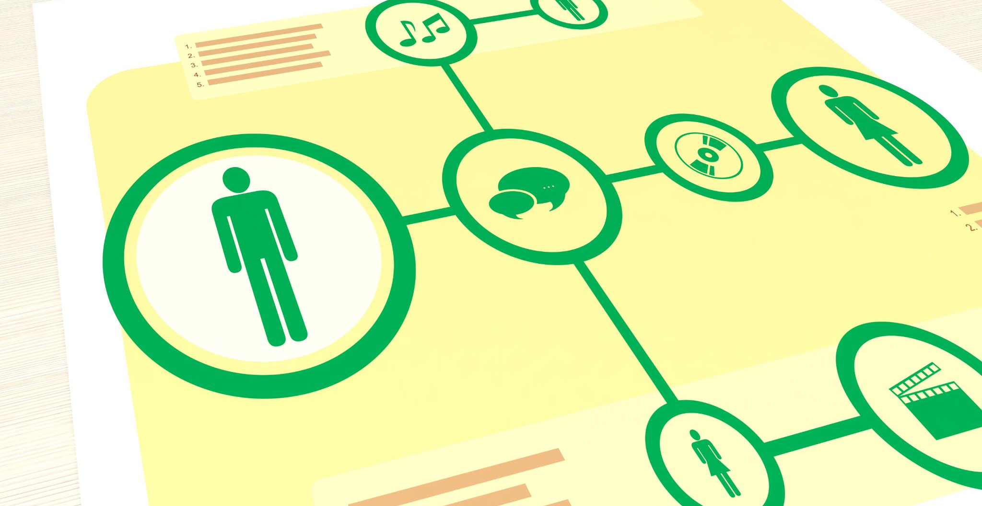
Best Practices
When using LangChain in production environments, it is important to follow best practices for version control, testing, and documentation to ensure an organized and efficient workflow.
Notes:
We will conclude by reviewing best practices for using LangChain in production environments. These best practices include version control, testing, and documentation.

